Slide 1



Theme B.2- Programming Constructs
B 2.3.2 Selection
Statement of Inquiry:The logical sequence and structure of a system determine its ability to make accurate decisions and solve complex problems.
Key concepts: logic
ATL Skill: Thinking , Research
Related concepts: Patterns
IB Learner Profile: Risk Takers
TOK Link :Knowledge & Algorithms: To what extent can we trust a "result" if the "process" (the sequence) is hidden from us?

Slide 2



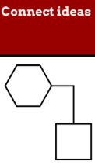
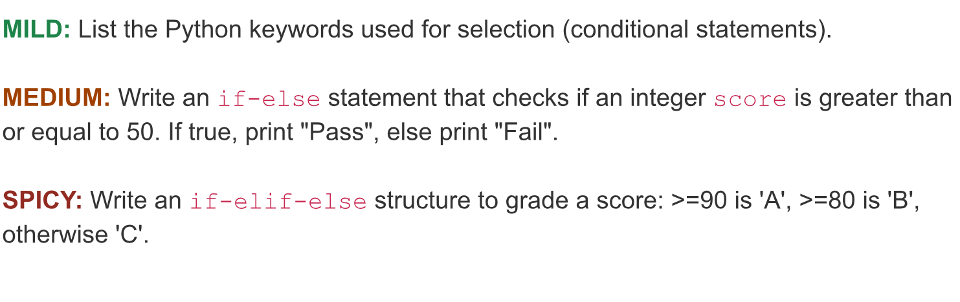


Do Now Activity
Pick one starter question according to your level, and discuss in your table .
Learning Intentions: To evaluate how the specific order of instructions affects the final output of a program.
Success Criteria:
Students will be able to explain the purpose and use of selection structures (if, else, else if/elif).
Students will be able to apply Boolean and relational operators to control program flow.
Students will be able to differentiate between if-else and multiple if statements.
Students will be able to implement selection structures within loops and nested loops.

Slide 3
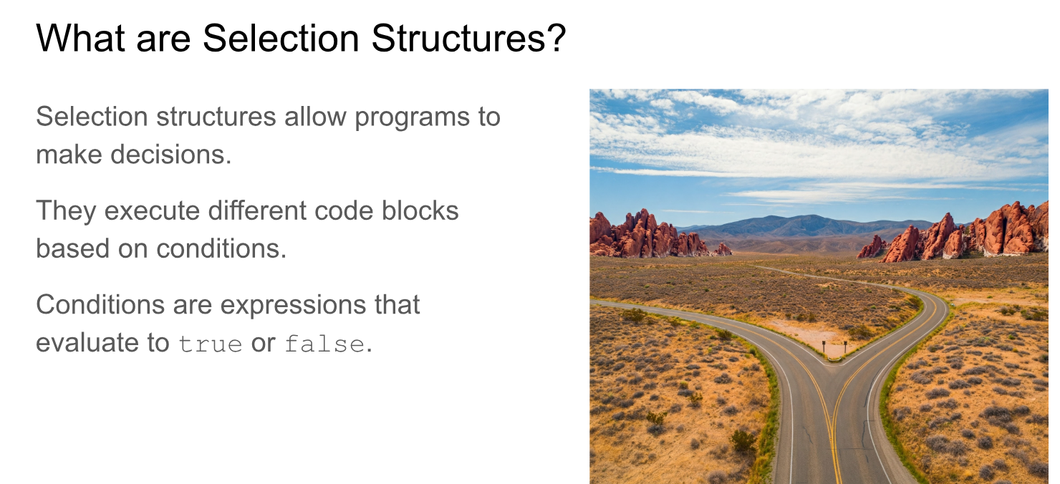

Slide 4
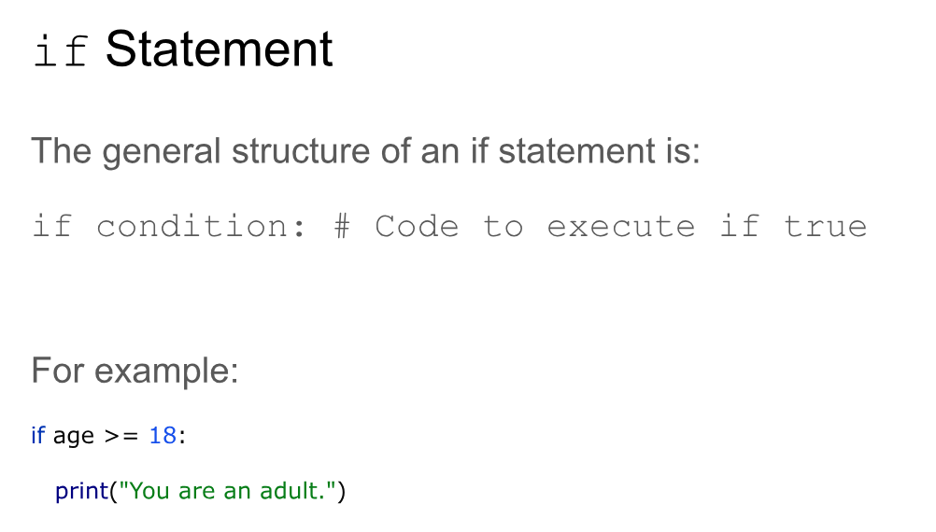

Slide 5
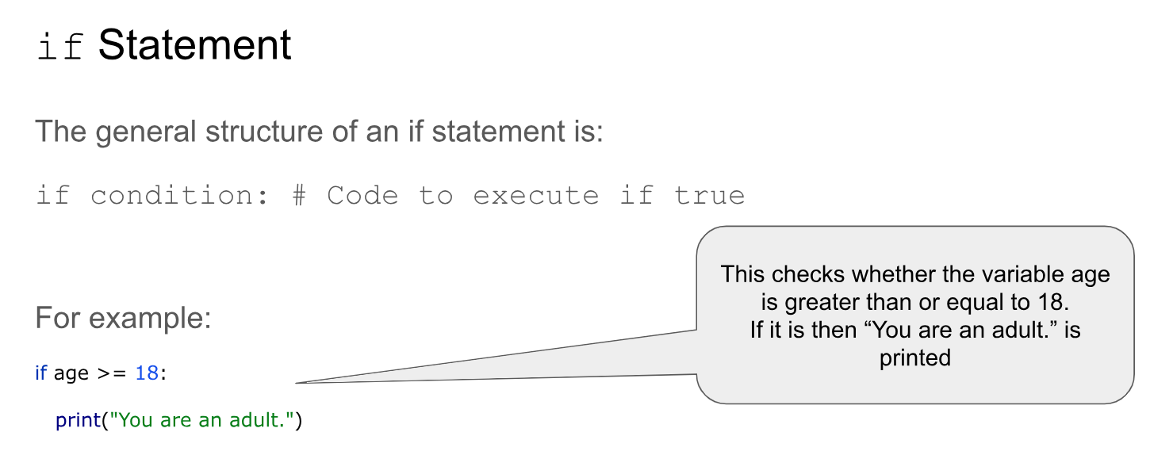

Slide 6
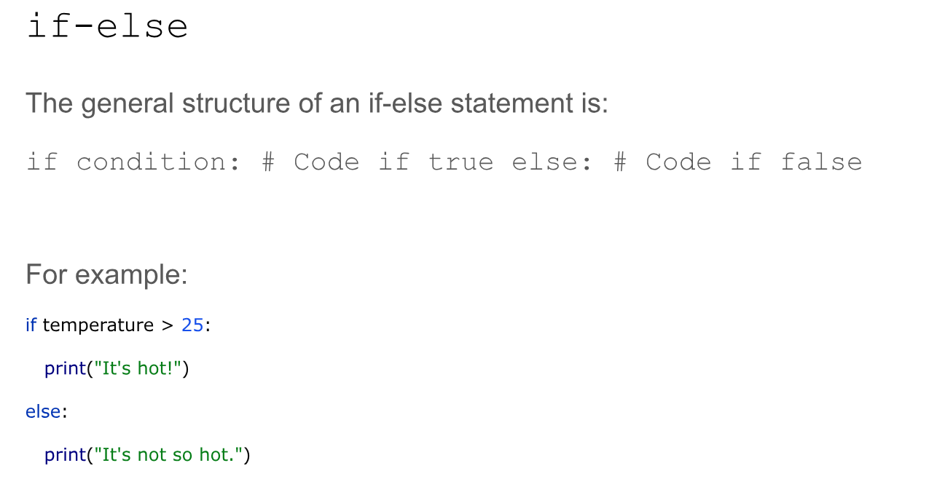

Slide 7
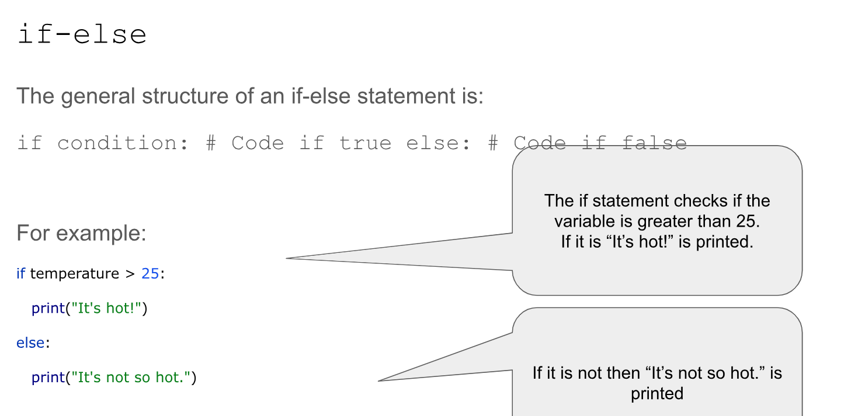

Slide 8
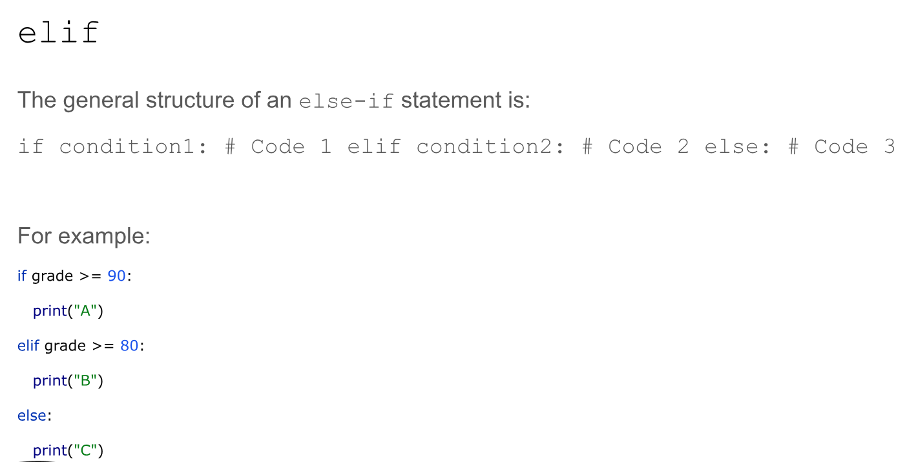

Slide 9
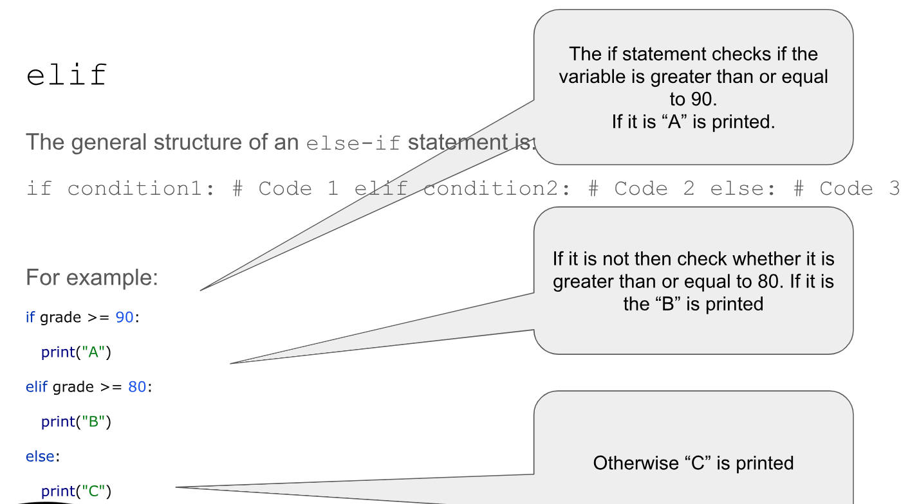

Slide 10
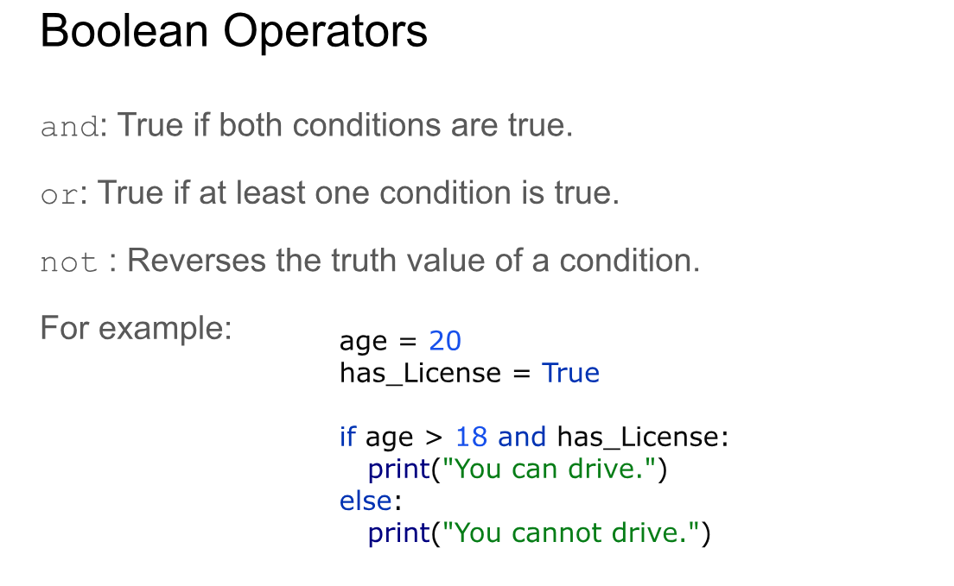

Slide 11
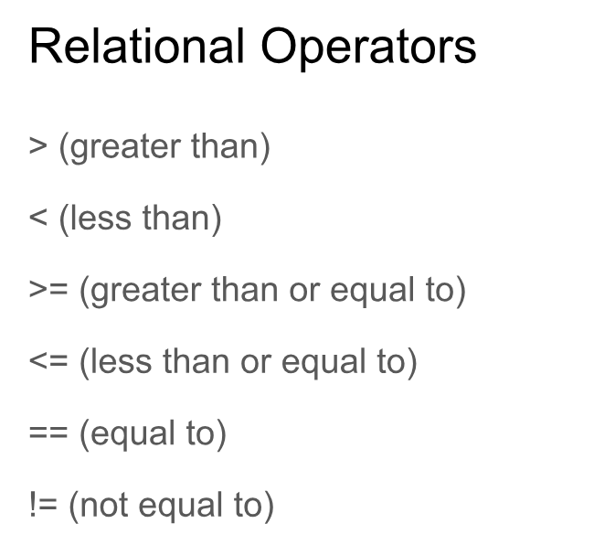

Slide 12
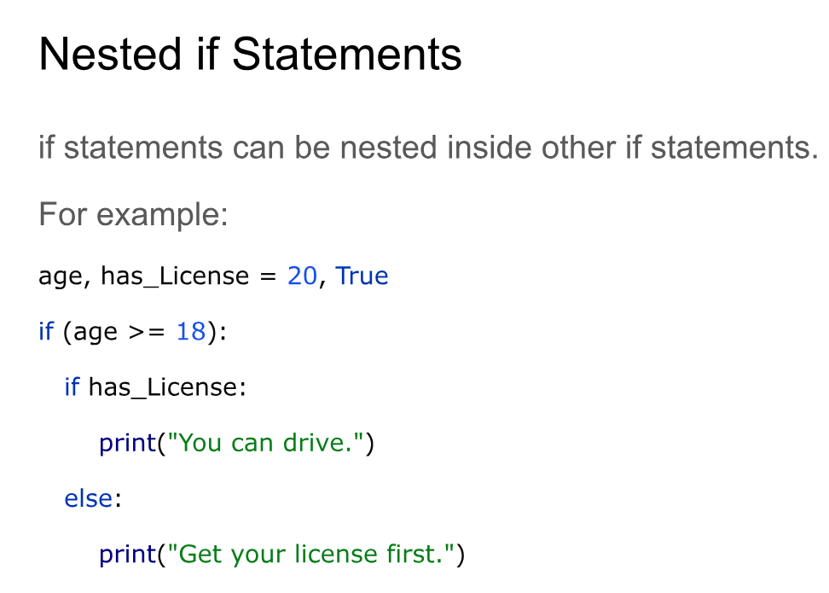

Slide 13
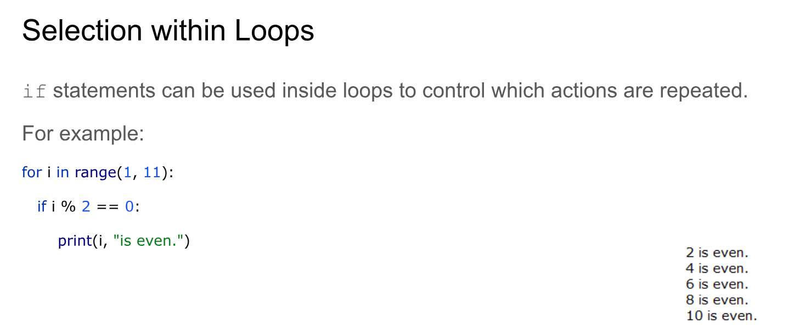

Slide 14
Activities Worksheet
https://docs.google.com/document/d/1JoW684LCL6x9Q5GPlQg9Rqh9jncOmxW_BbIbY-StWsw/edit?usp=sharing

